Slide 1
Introduction to sci-infinity and what the future holds -Event organization-
By: Amr Khaled Othman

Slide 2
Event date & location
Date: Monday the 10th of February at 10 a.m.
Location: Mansoura university, faculty of science, 4th floor prof. Dr. Ahmed Amin Hamza Hall (next to window lounge stairs)

Slide 3
The topic
The topic is an introduction to sci-infinity and what the future holds for the initiative where the speakers will explain the following points:
1- what is sci-infinity and what it stands for
2- the fields available in sci-infinity and what each of the contribute to the initiative
3- finally deliver the works in progress, future projects and hopes for the sci-infinity initiative

Slide 4
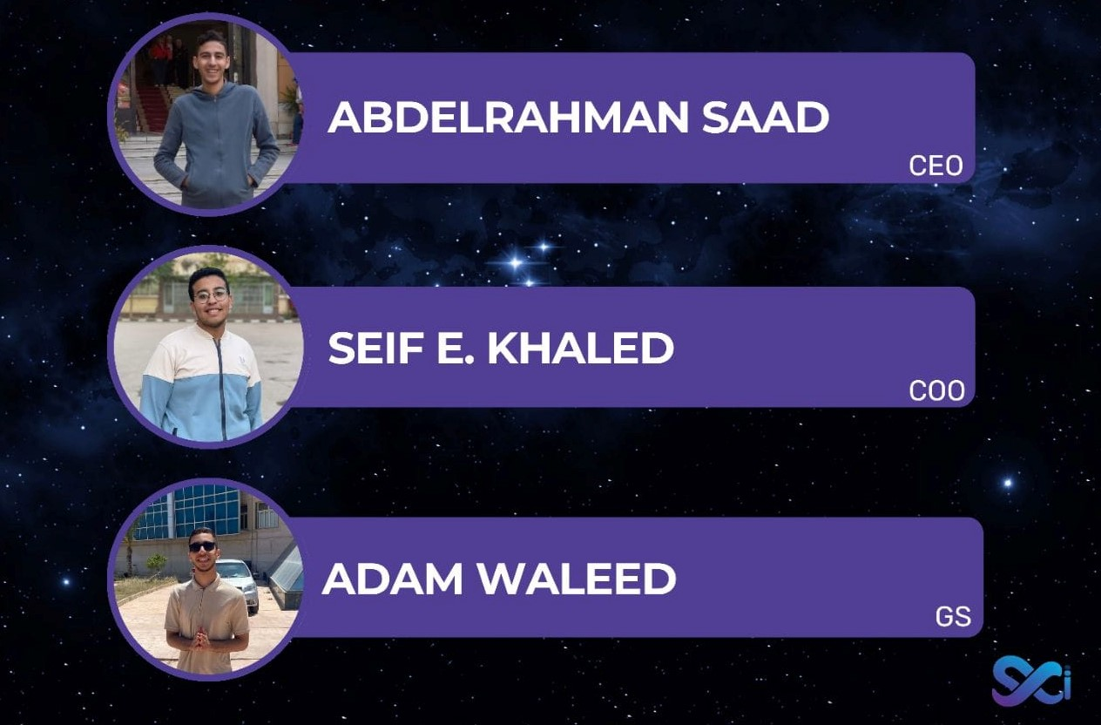
Speakers
Introduction:
1- Abdelrahman Saad -CEO-
2- Seif E. Khaled -COO-
3- Adam Waleed –GS-
Each will take turns explaining
The fundamentals of sci-infinity

Slide 5
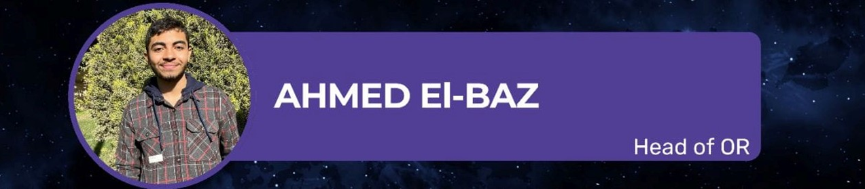

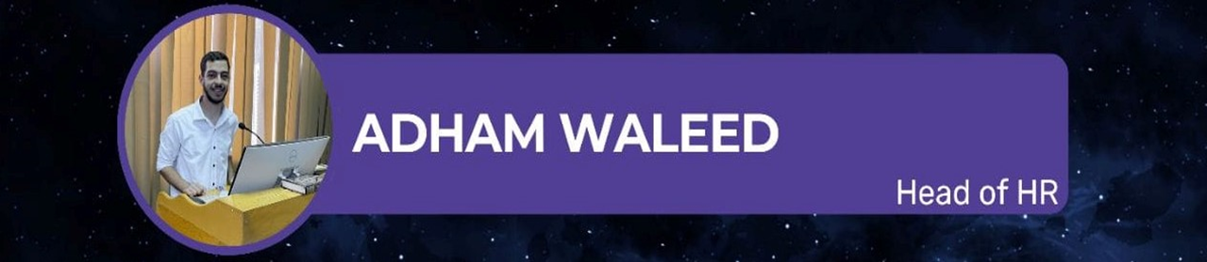
Speakers
Ahmed El-Baz:
The organization committee goals
Zeyad Hatem:
The media committee and presentation
Adham Waleed:
Communication with HR

Slide 6
Hall information
Capacity: 100
Attendees: approx. 75-85 Attendants
Devices available:
1- computer (working)
2-projector(working)
3- microphone (working)
4- speakers(working)

Slide 7
Timetable
Topic | Speaker | Start | End
Introduction to sci-infinity | - Abdelrahman Saad - Seif E. Khaled - Adam Waleed | 10:00 | 11:00
The organization committee goals | -Ahmed El-Baz | 11:05 | 11:30
The media committee and presentation | -Zeyad Hatem | 11:35 | 12:00
Communication with HR | -Adham Waleed | 12:05 | 12:30
quiz | - | 12:35 | 1:00

Slide 8
Activities
There will be questions asked throughout the event about the presented topic with small prizes given
At the end there will also be a quiz about the event were the attendant's paying attention can win a grand prizes like:
- gift card to café
- Free university certified and provided courses like (programing, English language and soft skills )

Slide 9
END

